Slide 1

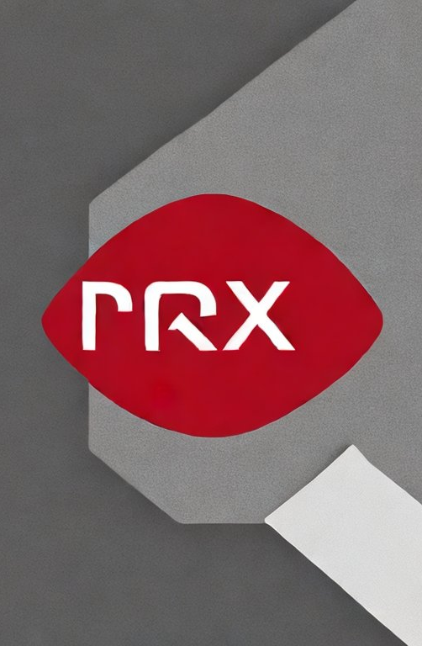
Praxi
The AI-Powered Platform for Dental Equipment Maintenance and Regulatory Compliance

Slide 2

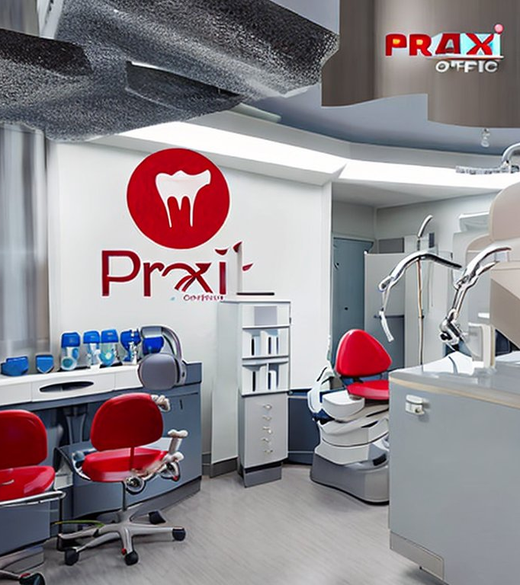



Introduction
Dental offices have complex equipment maintenance and regulatory compliance requirements.
Praxi helps dental clinic operators stay current with equipment maintenance and regulatory compliance with ease.
Praxi's AI-powered platform automates workflows and reduces the risk and expense of non-compliance.
Praxi enables predictive maintenance, which saves time and money in the long run.

Slide 3

Problem
Most dental offices keep maintenance and regulatory reminders on sticky notes.
Unnecessary repairs and equipment downtime occur due to non-compliance.
Random office checks are executed by regulatory departments.
Dental clinic operators are at risk of large fines and possible closure due to non-compliance.
High turnover and lack of re-training can lead to staff errors.
Image prompt: An image of a pile of sticky notes with maintenance and regulatory reminders written on them, with an unhappy dental staff member or a piece of equipment in the background.

Slide 4
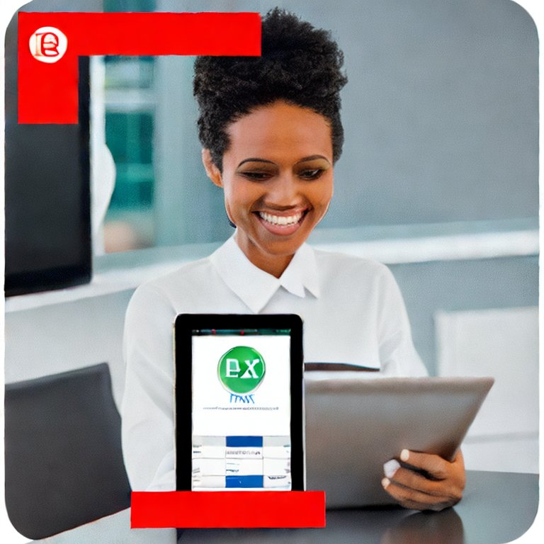
Solution
Praxi provides dental clinic operators with all the necessary tools to execute adequate, timely maintenance and regulatory requirements with confidence.
AI-powered platform automates workflows and notifications, reducing the risk and expense of non-compliance.
Praxi's platform offers reward and referral programs, which can help dental clinic operators reduce their subscription costs.
Praxi enables dental clinic operators to monitor their equipment's health and compliance with ease, which saves them time and money in the long run.

Slide 5
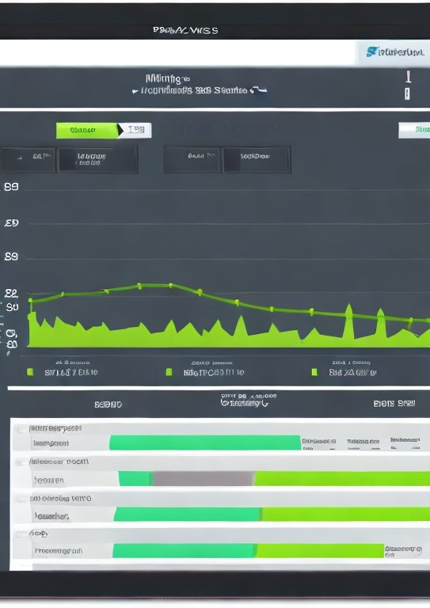
Key Features
Maintenance and regulatory notifications with how-to videos and documentation.
Repair tracking and requests.
Serial number and error code decoder.
Documents and videos that are easy to attach to email for sales and technicians.
Dashboard for single and multi-location offices.

Slide 6
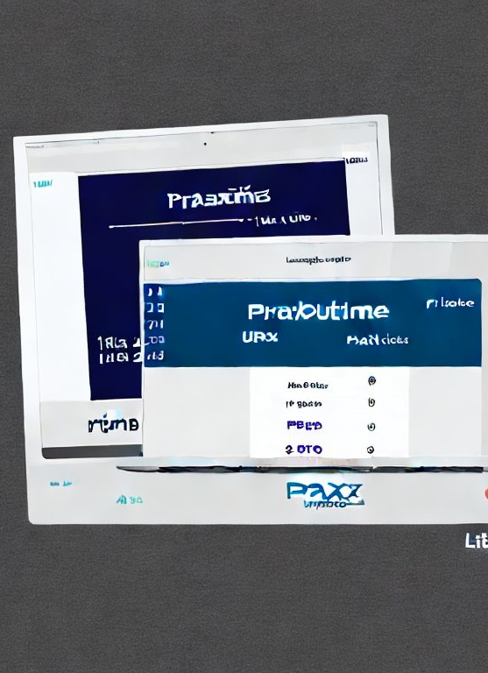
Key Benefits of Praxi vs. UpTime Health
Praxi's platform is tailored specifically to dental equipment maintenance and regulatory compliance, while UpTime Health caters to a wider range of healthcare equipment.
Praxi's platform is AI-powered, which automates workflows and notifications, reduces the risk and expense of non-compliance, and enables predictive maintenance. UpTime Health does not provide AI-powered capabilities.
Praxi's platform offers a reward program and referral program, which can help dental clinic operators reduce their subscription costs. UpTime Health does not offer these programs.
Praxi provides dental clinic operators with the peace of mind that their staff is completing necessary and timely maintenance and regulatory requirements.
Praxi allows dental clinic operators to monitor their equipment's health and compliance with ease, which saves them time and money in the long run.

Slide 7
The Benefits for Dental Clinic Operators
Praxi provides dental clinic operators with the peace of mind that their staff is completing necessary and timely maintenance and regulatory requirements.
Praxi allows dental clinic operators to monitor their equipment's health and compliance with ease, which saves them time and money in the long run.
Praxi's platform enables predictive maintenance, which reduces equipment downtime and maintenance costs.
Praxi's reward and referral programs can help dental clinic operators reduce their subscription costs.
Praxi's AI-powered platform automates workflows and notifications, reducing the risk and expense of non-compliance.

Slide 8

The Benefits for Staff
Praxi eliminates the need for staff to worry about staying current with maintenance and regulatory protocols.
Praxi ensures that the right protocols are being performed, which reduces staff workload and allows them to focus on patient care, benefiting dental clinic operators and their patients.
Praxi's platform offers easy-to-follow how-to videos and documentation, which reduces the need for staff training.
Praxi's AI-powered platform automates workflows and notifications, reducing the risk and expense of non-compliance.
Praxi's platform enables predictive maintenance, which reduces equipment downtime and maintenance costs.

Slide 9
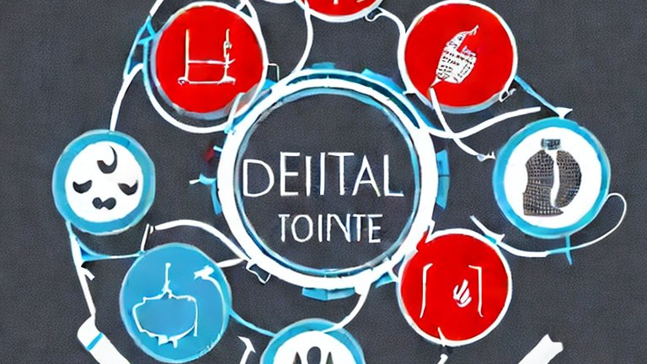
The Benefits for Multi-Site Offices
Praxi allows multi-site offices to verify and track maintenance and regulatory requirements across their entire network of offices.
Praxi's platform provides real-time data on equipment performance and compliance metrics, allowing executives to make data-driven decisions.
Praxi's AI-powered platform automates workflows and notifications, reducing the risk and expense of non-compliance.
Praxi's platform enables predictive maintenance, which reduces equipment downtime and maintenance costs.
Praxi's dashboard for multi-location offices provides a comprehensive overview of equipment health and compliance metrics.

Slide 10
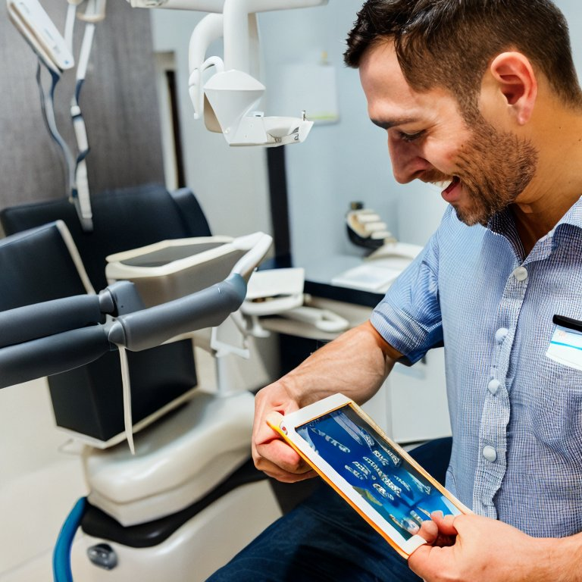
The Benefits for Sales Reps and Techs
Praxi's platform provides dental sales reps and techs with all equipment-related documents in one easy-to-search location.
Praxi's platform enables sales reps and techs to quickly access critical information and troubleshoot equipment issues faster.
Praxi's AI-powered platform automates workflows and notifications, reducing the risk and expense of non-compliance.
Praxi's platform enables predictive maintenance, which reduces equipment downtime and maintenance costs.
Praxi's platform improves communication between sales reps, techs, and dental clinic operators.
Image prompt: An image of a dental sales rep or tech using the Praxi platform on a mobile device, with equipment in the background and the Praxi logo overlaid in the corner.

Slide 11
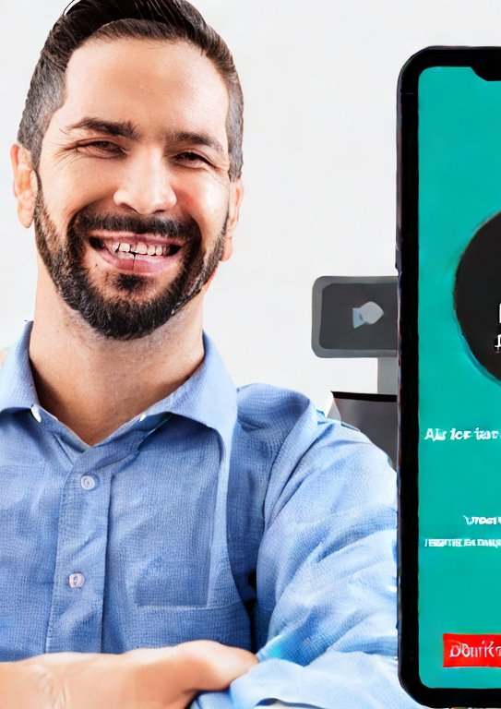
Sign Up Today
Take advantage of all the platform's benefits and simplify your dental equipment maintenance and regulatory compliance requirements

